Slide 1
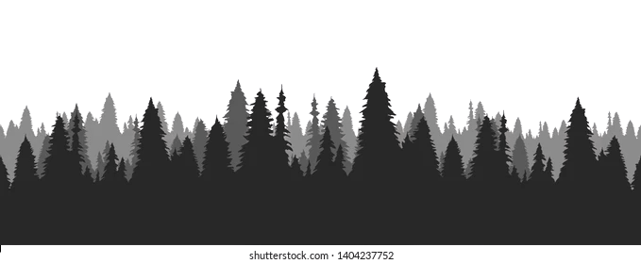

Spatial Soundscape Analysis with an Acoustic Vector Sensor
in collaboration with Prof. Holger Klinck
K. Lisa Yang Center for Conservation Bioacoustics
Tolkova I, Klinck H. “Source Separation with an Acoustic Vector Sensor for Terrestrial Bioacoustics”
Journal of the Acoustical Society of America, 2022

Slide 2

“In its most comprehensive finding to date, this edition shows an average 69% decline in the relative abundance of monitored wildlife populations around the world between 1970 and 2018.”
World Wildlife Fund’s Living Planet Report, 2022

Slide 3
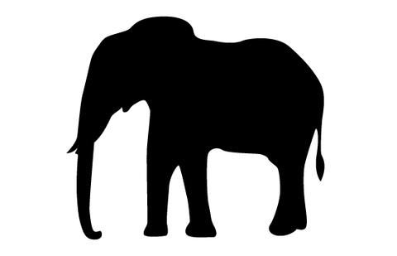



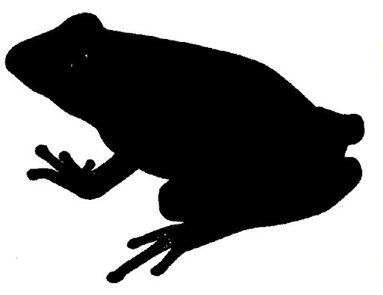

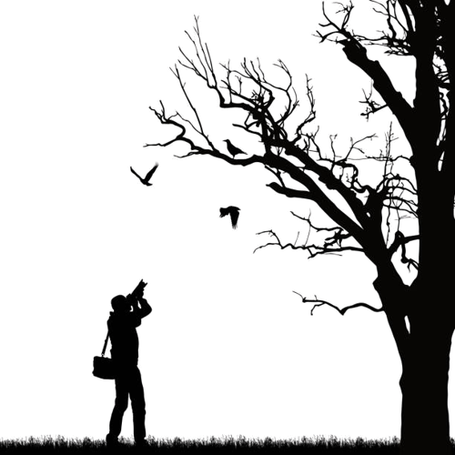




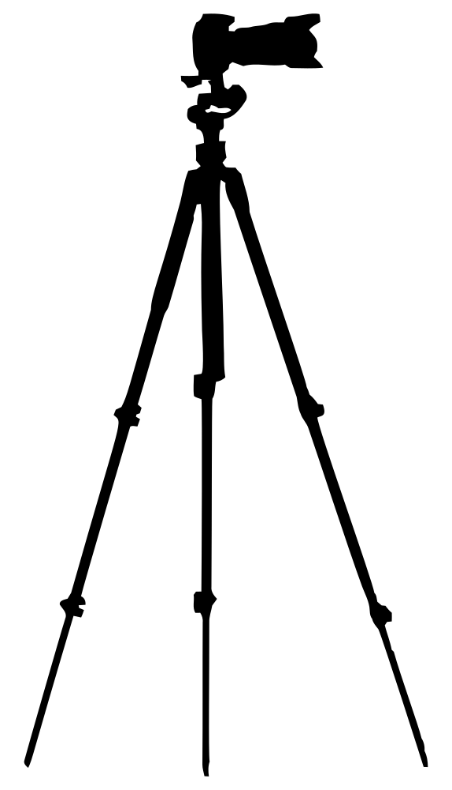
To initiate, implement, and evaluate conservation programs, we need to understand what species are present, how large their populations are, and how this changes over time.
Traditionally, wildlife monitoring was done through manual observation.
Now, we have the capability to automate and expand monitoring efforts through passive acoustic monitoring.

Slide 4



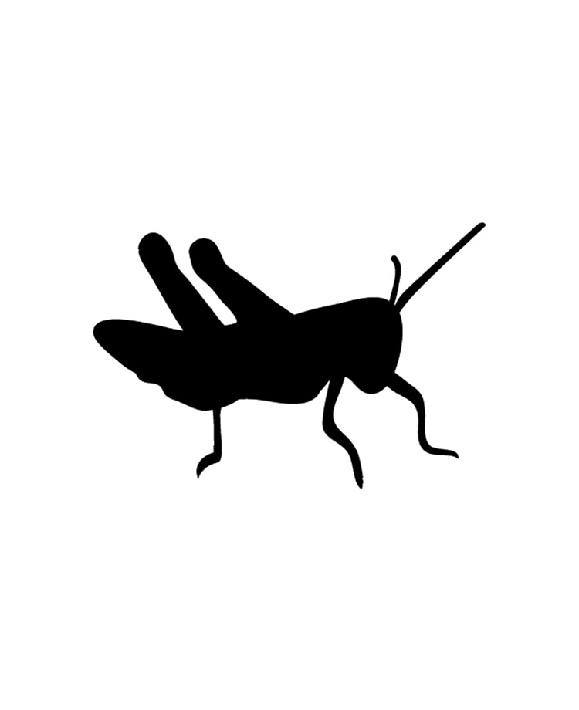

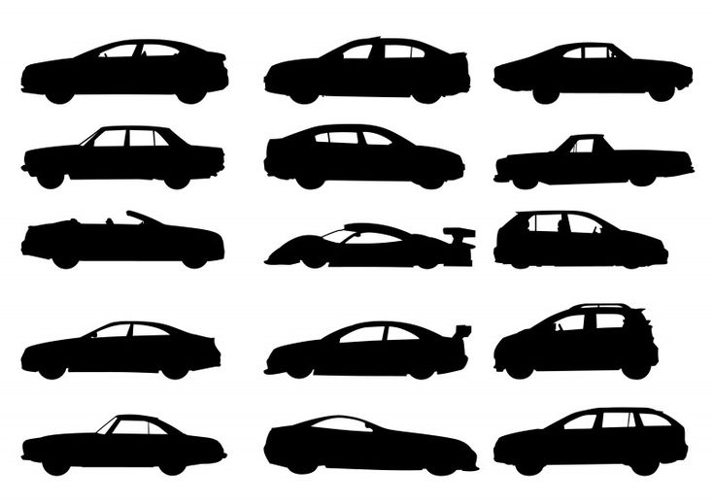
Challenges to Passive Acoustic Monitoring
The complexity of real-world soundscapes, especially relative to training data, is a pervasive challenge for automated classification systems.
Ideal Scenario
Typical Scenario

Slide 5
Challenges to Passive Acoustic Monitoring
The complexity of real-world soundscapes, especially relative to training data, is a pervasive challenge for automated classification systems.
Training
Deployment

Slide 6
Challenges to Passive Acoustic Monitoring
The complexity of real-world soundscapes, especially relative to training data, is a pervasive challenge for automated classification systems.
Training
Deployment
Could we address these challenges by separating different sound sources in the environment?

Slide 7
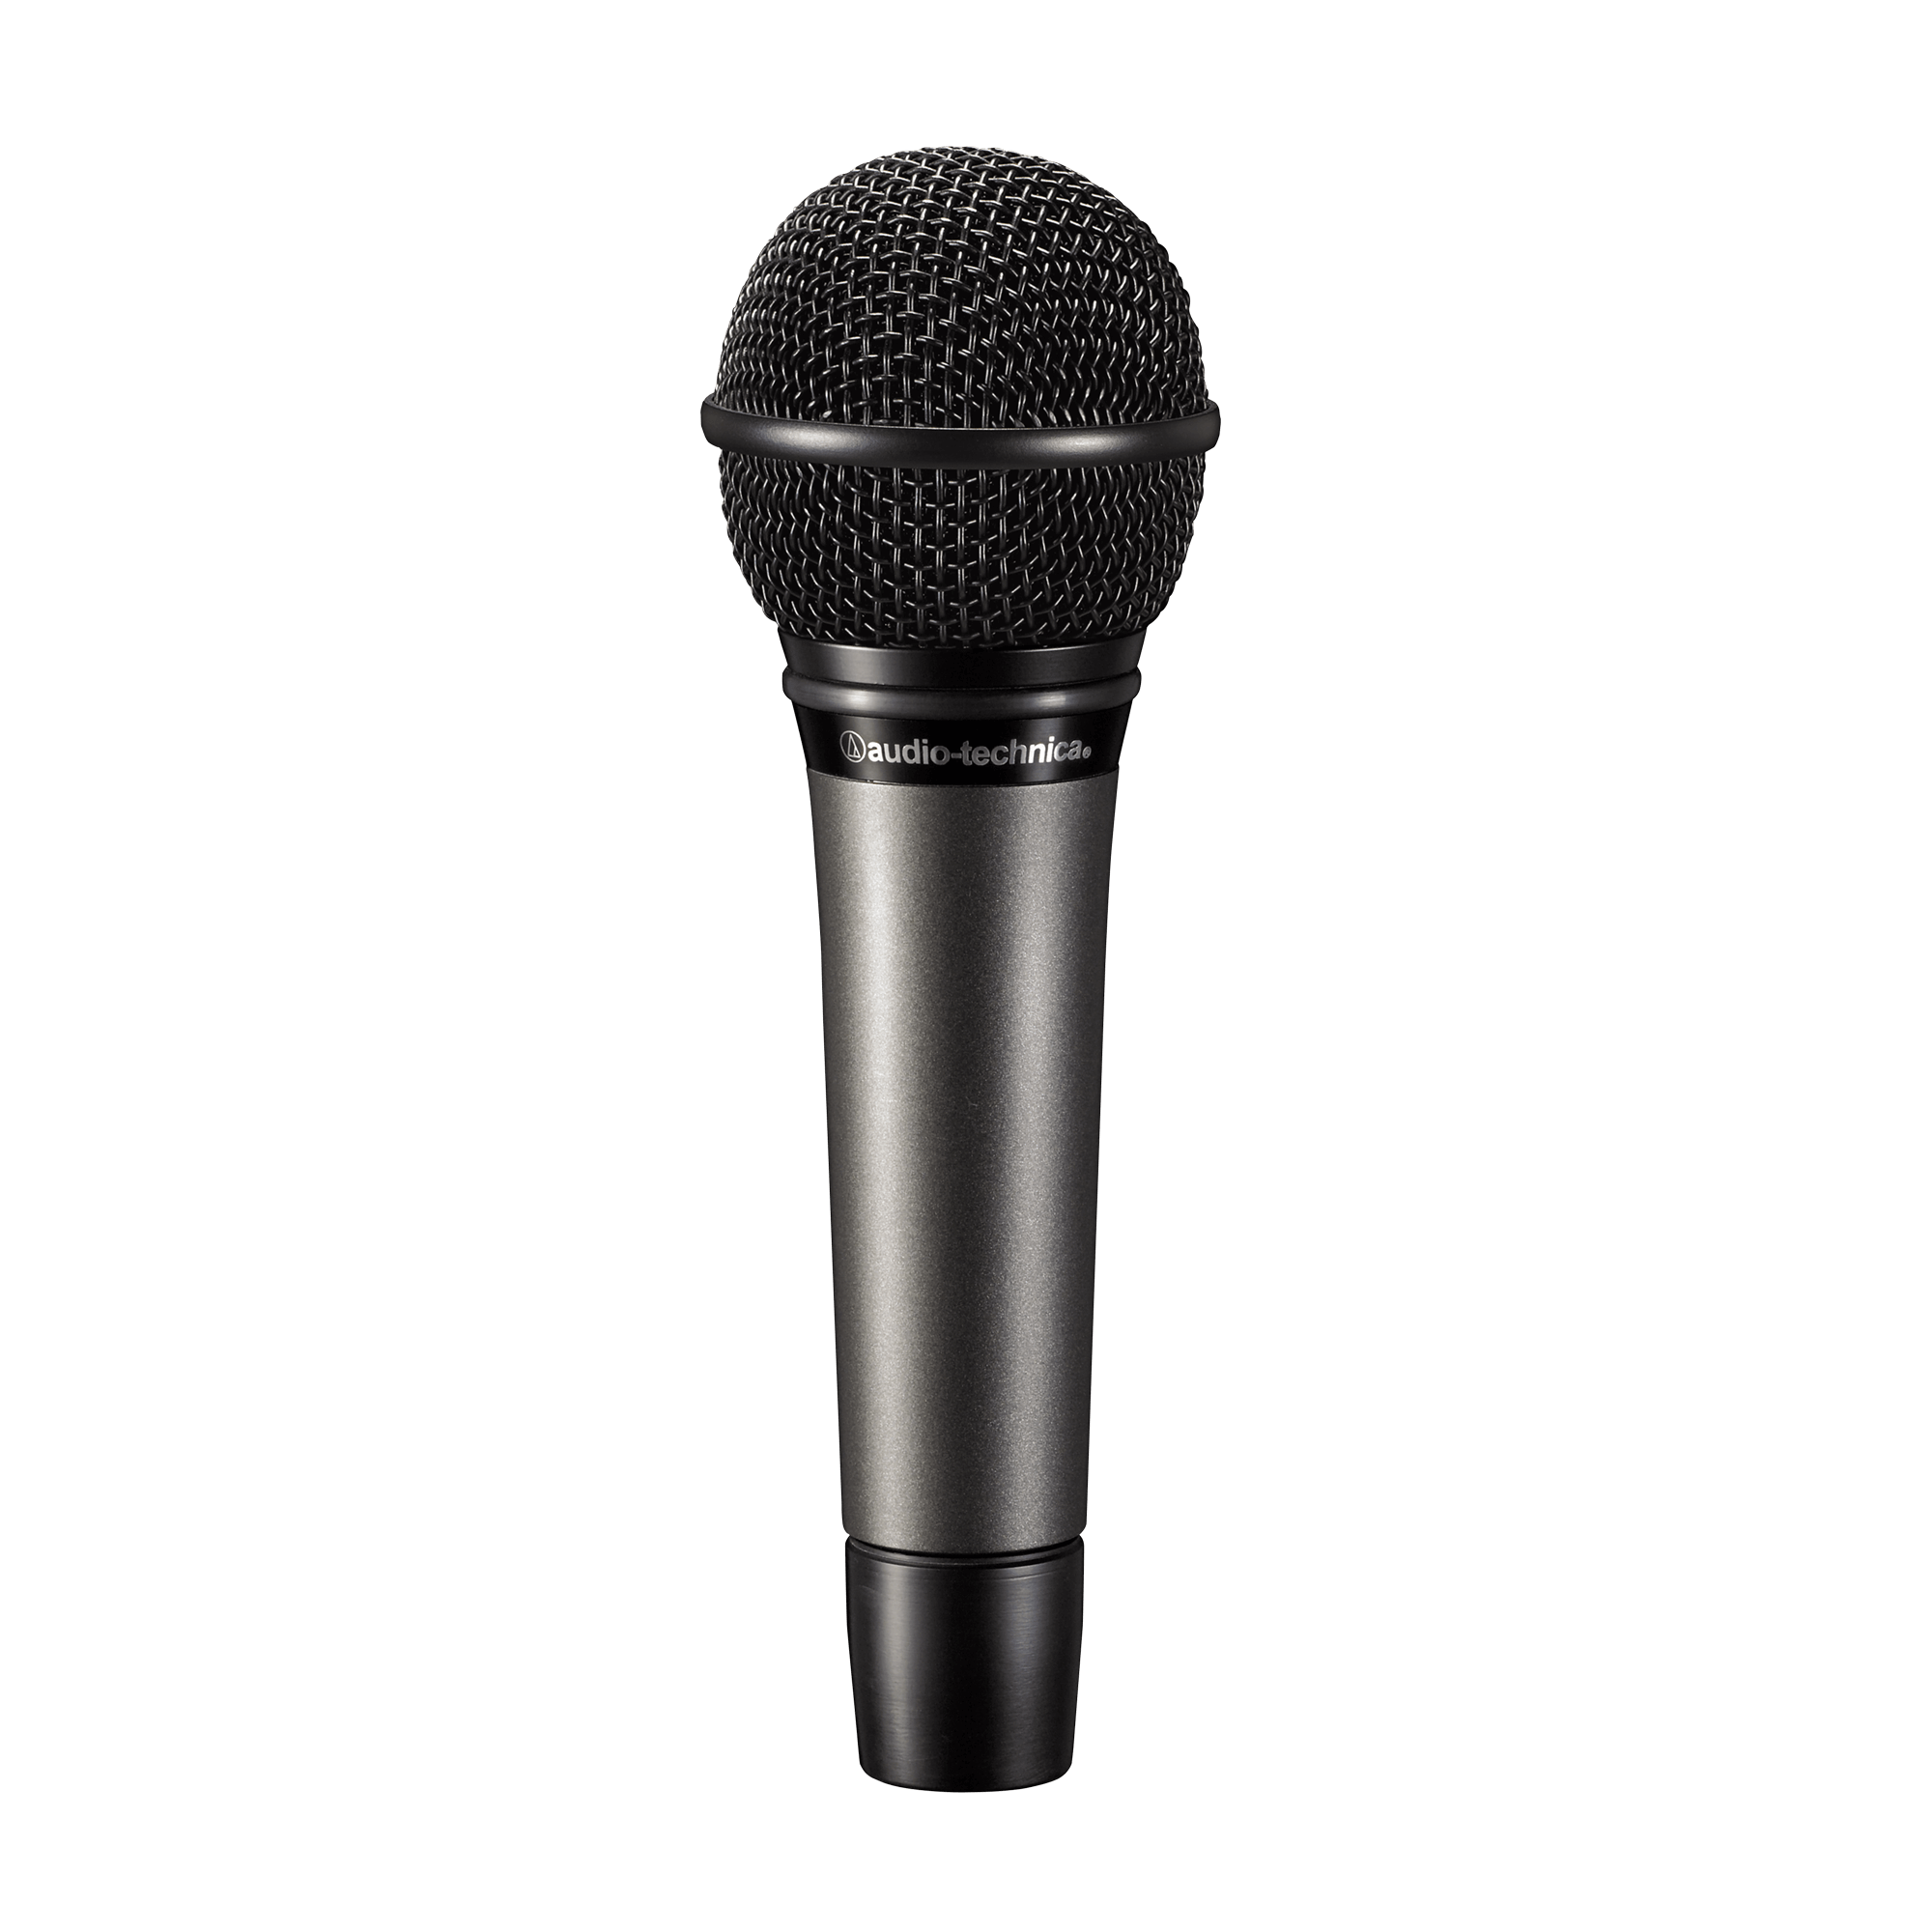
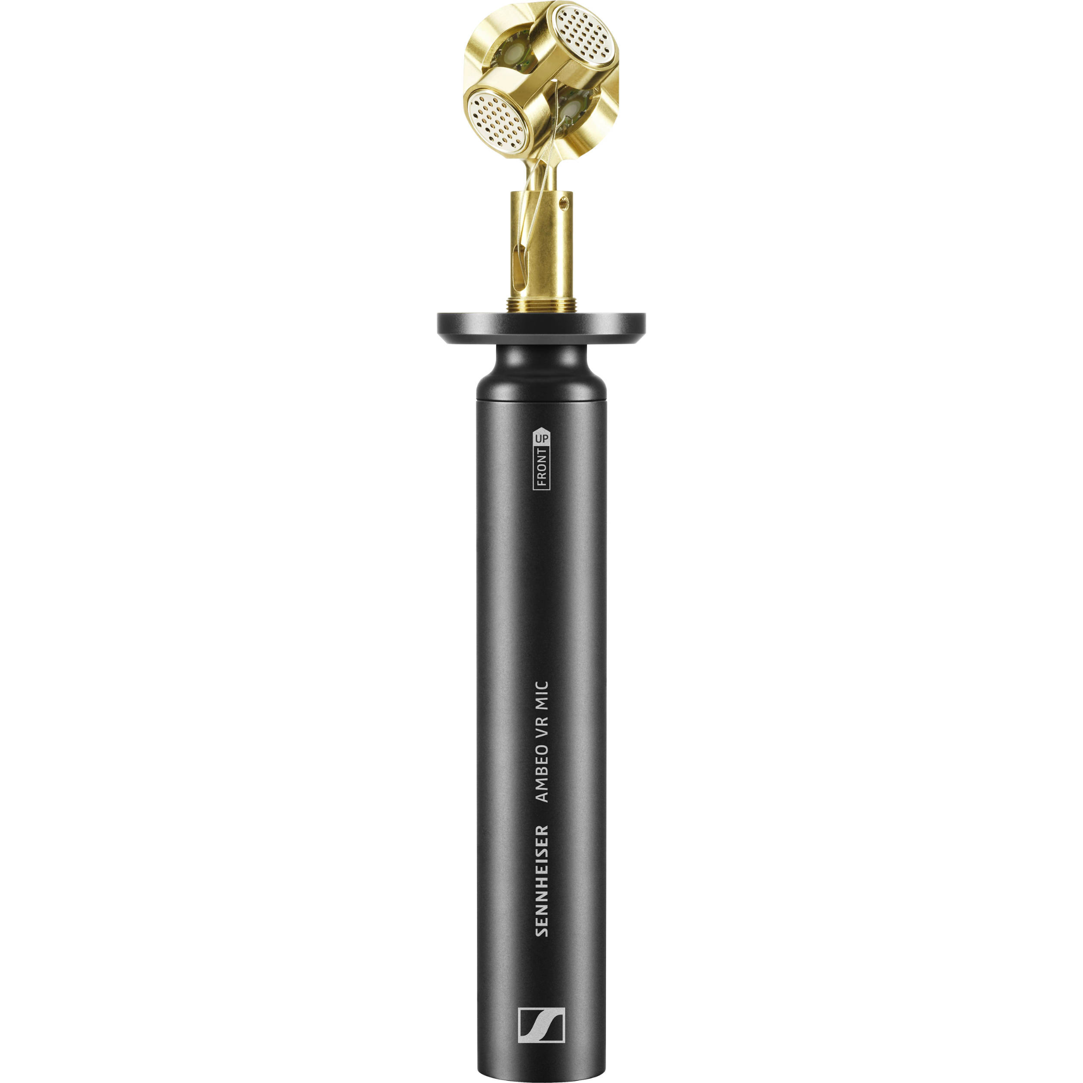
Choice of Hardware
single microphone
microphone array
co-located microphone array
omnidirectional
directional
omnidirectional
directional
directional
directional
Advantage:
simple analysis
Challenge:
source separation is under-determined
Advantages:
can separate sound sources based on time-difference-of-arrival
Challenges:
higher cost
more maintenance
clock drift
Possible Advantages:
relatively low-cost…
can separate sound sources based on directionality!

Slide 8
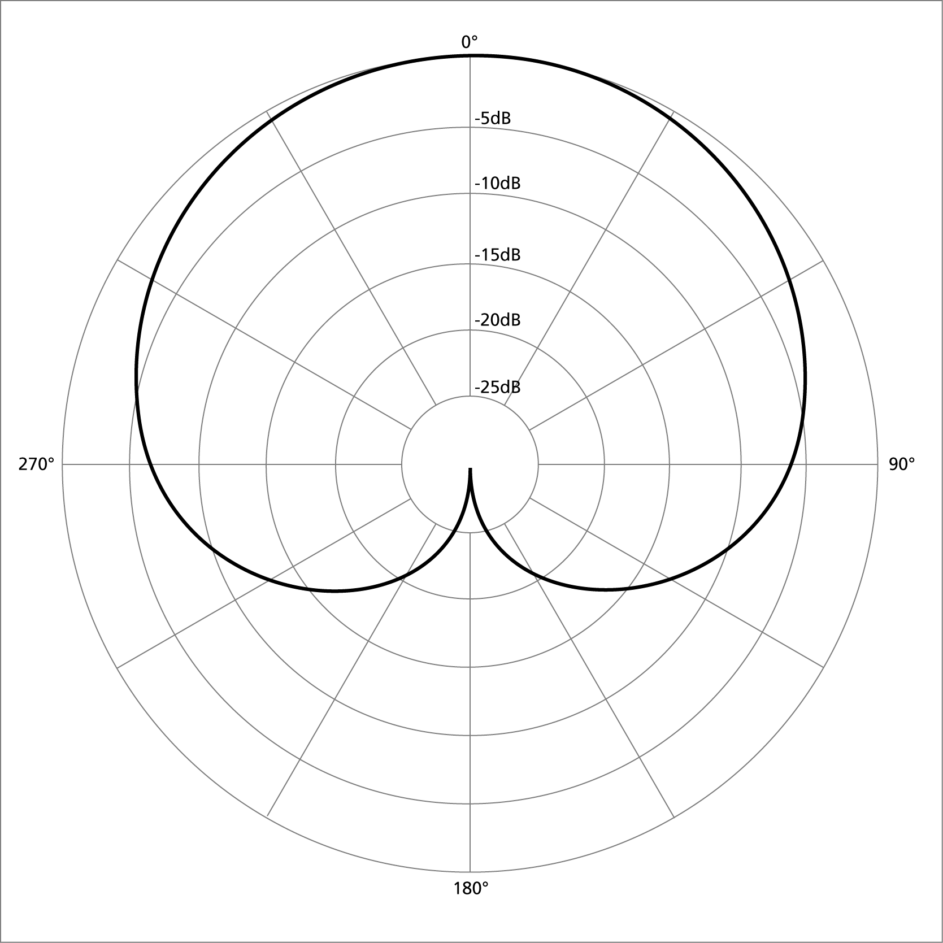

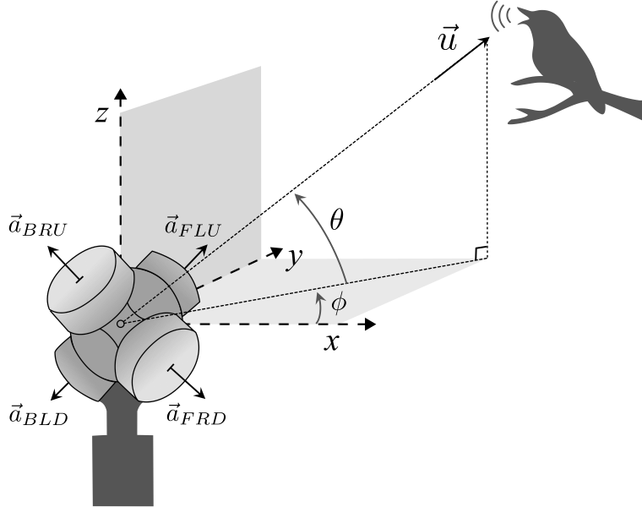
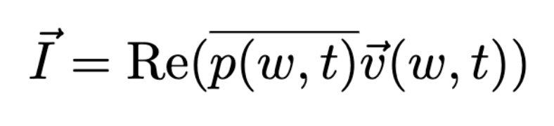
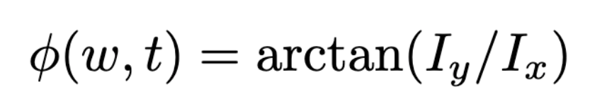
DoA Estimation with an Acoustic Vector Sensor
Goal: calculate acoustic direction-of-arrival (DoA): azimuth angle 𝜙 and elevation angle 𝜽.
This microphone is a tetrahedral arrangement of four cardioid capsules.
A linear combination of the measurements will give an output proportional to the acoustic pressure and acoustic velocity.
elevation
angle
DoA Estimation:
azimuth angle
calculate pressure and velocity:
calculate active intensity vector:
calculate azimuth for each pixel:

Slide 9


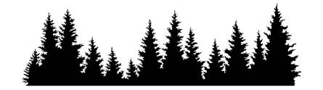
Active Intensity Method (AIM)
Acoustic vector sensors have been used in navy and military operations, and in spatial audio.
They have recently been leveraged in marine bioacoustics for monitoring whales.
However, to our knowledge, they have not been used in terrestrial bioacoustics.
I will first demonstrate and evaluate source separation experimentally…
…and then deploy the techniques for a field recording of a wildlife refuge.

Slide 10
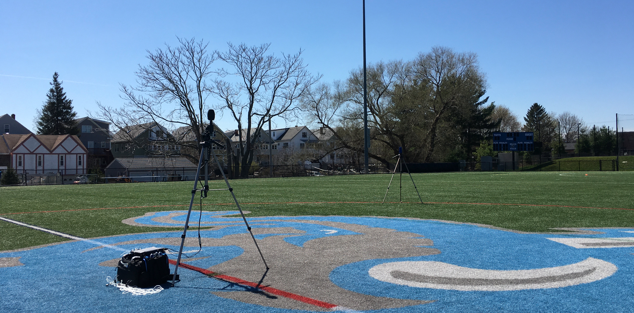
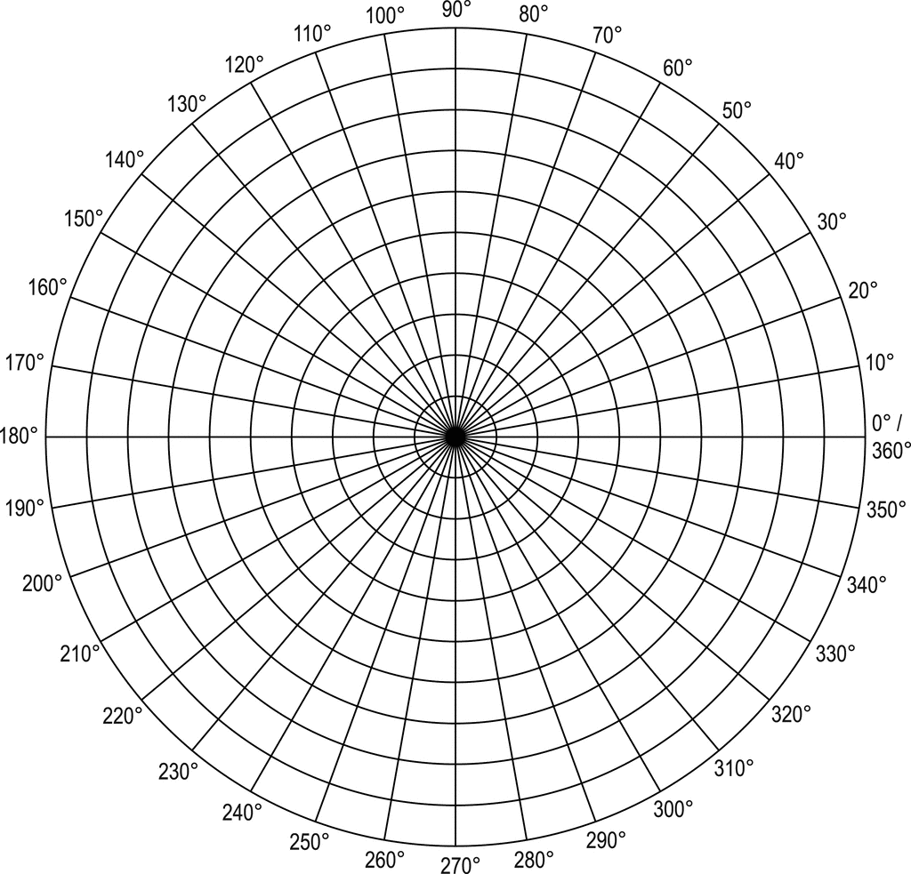

Evaluation of AIM
I compared DoA estimation with the active intensity method (AIM) against two baseline algorithms, in simulation and through experiments:
White noise gain constraint beamforming (WNC)
Multiple signal classification (MUSIC)
microphone
speaker
In all, we find that the intensity-based method outperforms other DoA estimation methods for this problem, and…
→ Can estimate DoA with mean errors of around 5 degrees
→ Can distinguish two sources separated by at least 10 degrees
→ Is robust to signal-to-noise ratio, signal distance, and signal duration.

Slide 11
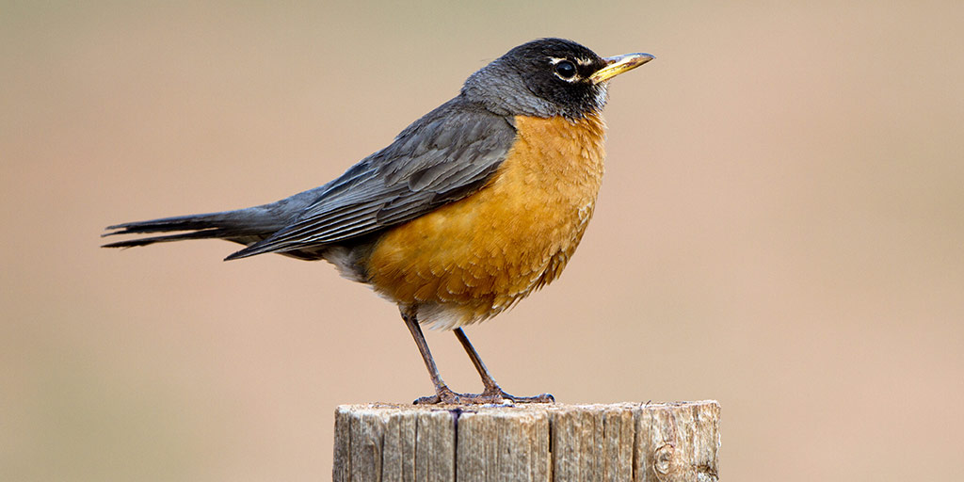
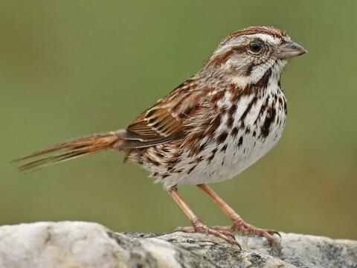
Source Separation
So, how does direction-of-arrival (DOA) estimation lead to source separation?
45°
0°
Consider two speakers separated by 45°, playing two birdsong segments.

Slide 12
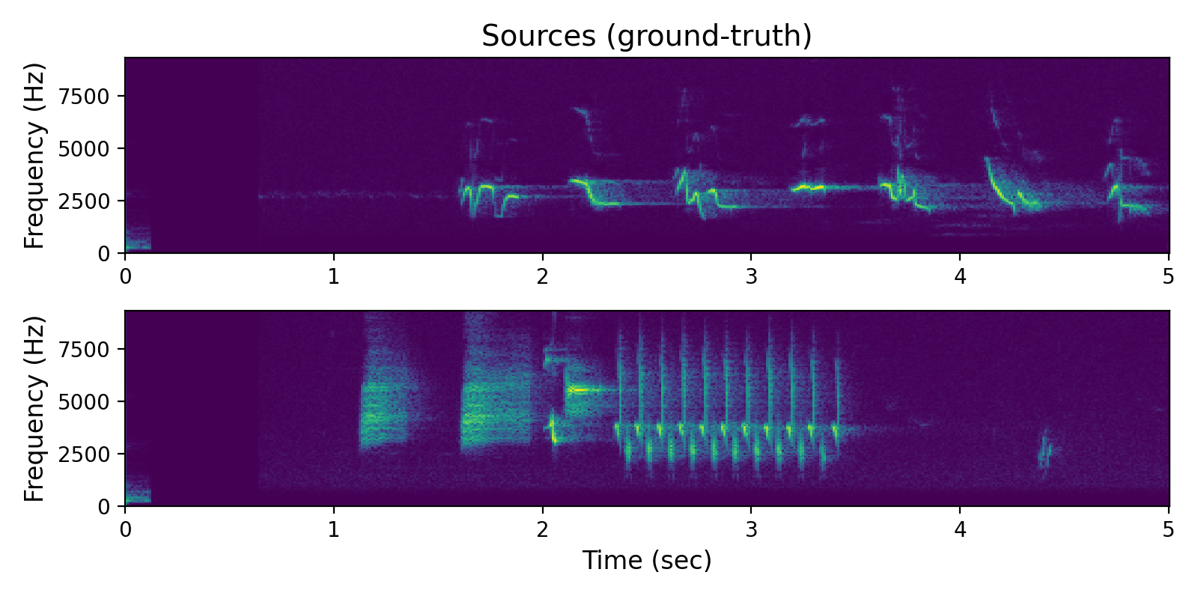

Source Separation
Here are the two ground-truth signals:
So, how does direction-of-arrival (DOA) estimation lead to source separation?
45°
0°
Consider two speakers separated by 45°, playing two birdsong segments.

Slide 13
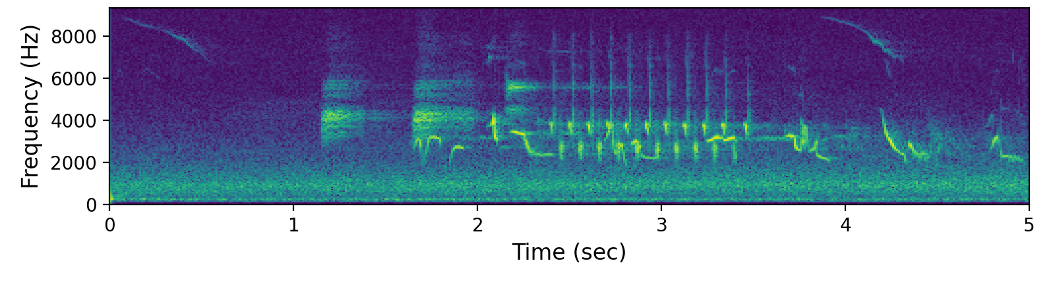
Source Separation
Here are the two ground-truth signals:
So, how does direction-of-arrival (DOA) estimation lead to source separation?
45°
0°
Here is the measured pressure; a mixture of the two recordings:
Consider two speakers separated by 45°, playing two birdsong segments.

Slide 14
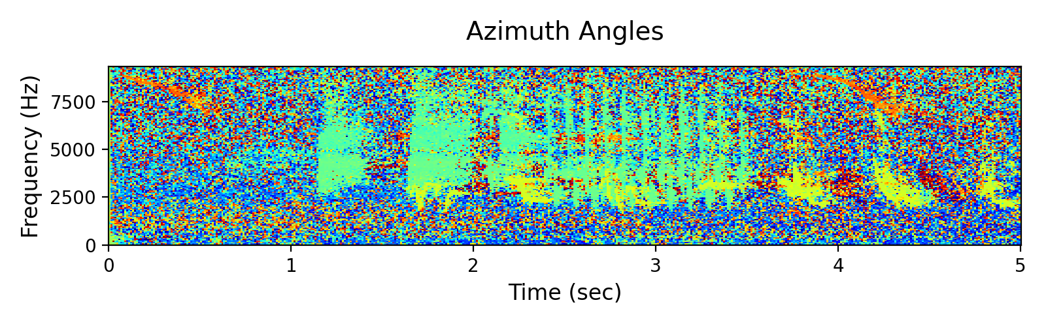
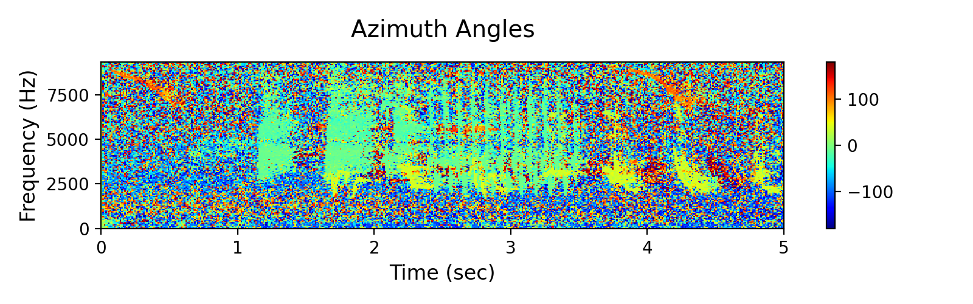
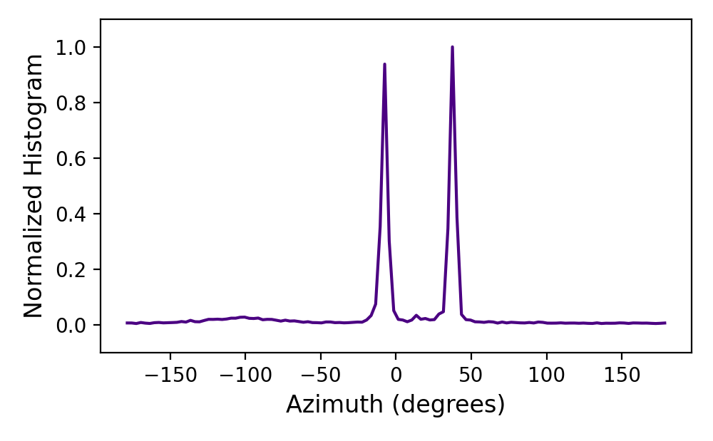
Source Separation
Using AIM, we can calculate an azimuth value for each pixel:
Next, we take the histogram over azimuth angles:
We clearly see two peaks separated by 45°!

Slide 15
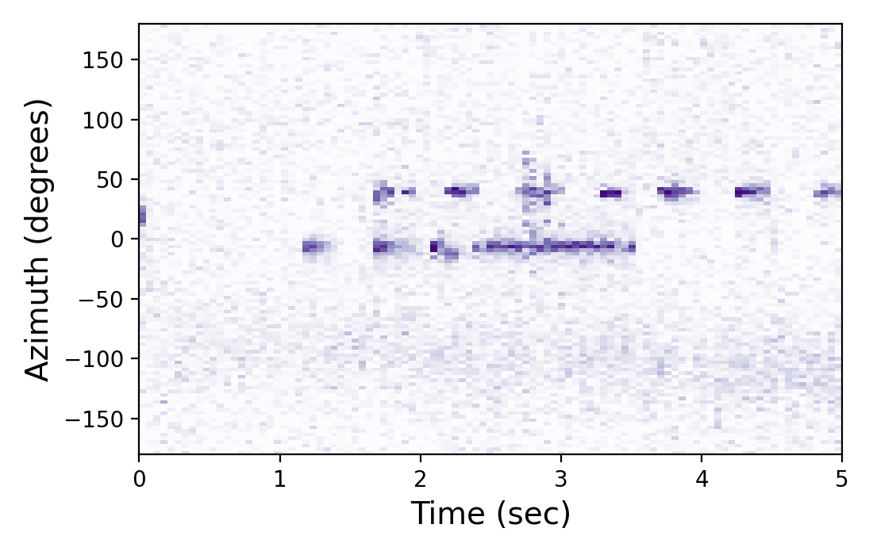
Source Separation
Using AIM, we can calculate an azimuth value for each pixel:
What if we incorporate temporal resolution, and calculate a histogram across both azimuth and time?
Next, we take the histogram over azimuth angles:
We clearly see two peaks separated by 45°!

Slide 16
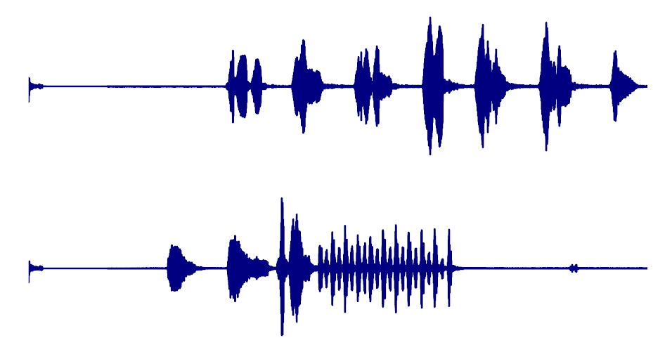
Source Separation
Using AIM, we can calculate an azimuth value for each pixel:
What if we incorporate temporal resolution, and calculate a histogram across both azimuth and time?
Next, we take the histogram over azimuth angles:
We see a resemblance to the original signals:
We clearly see two peaks separated by 45°!

Slide 17
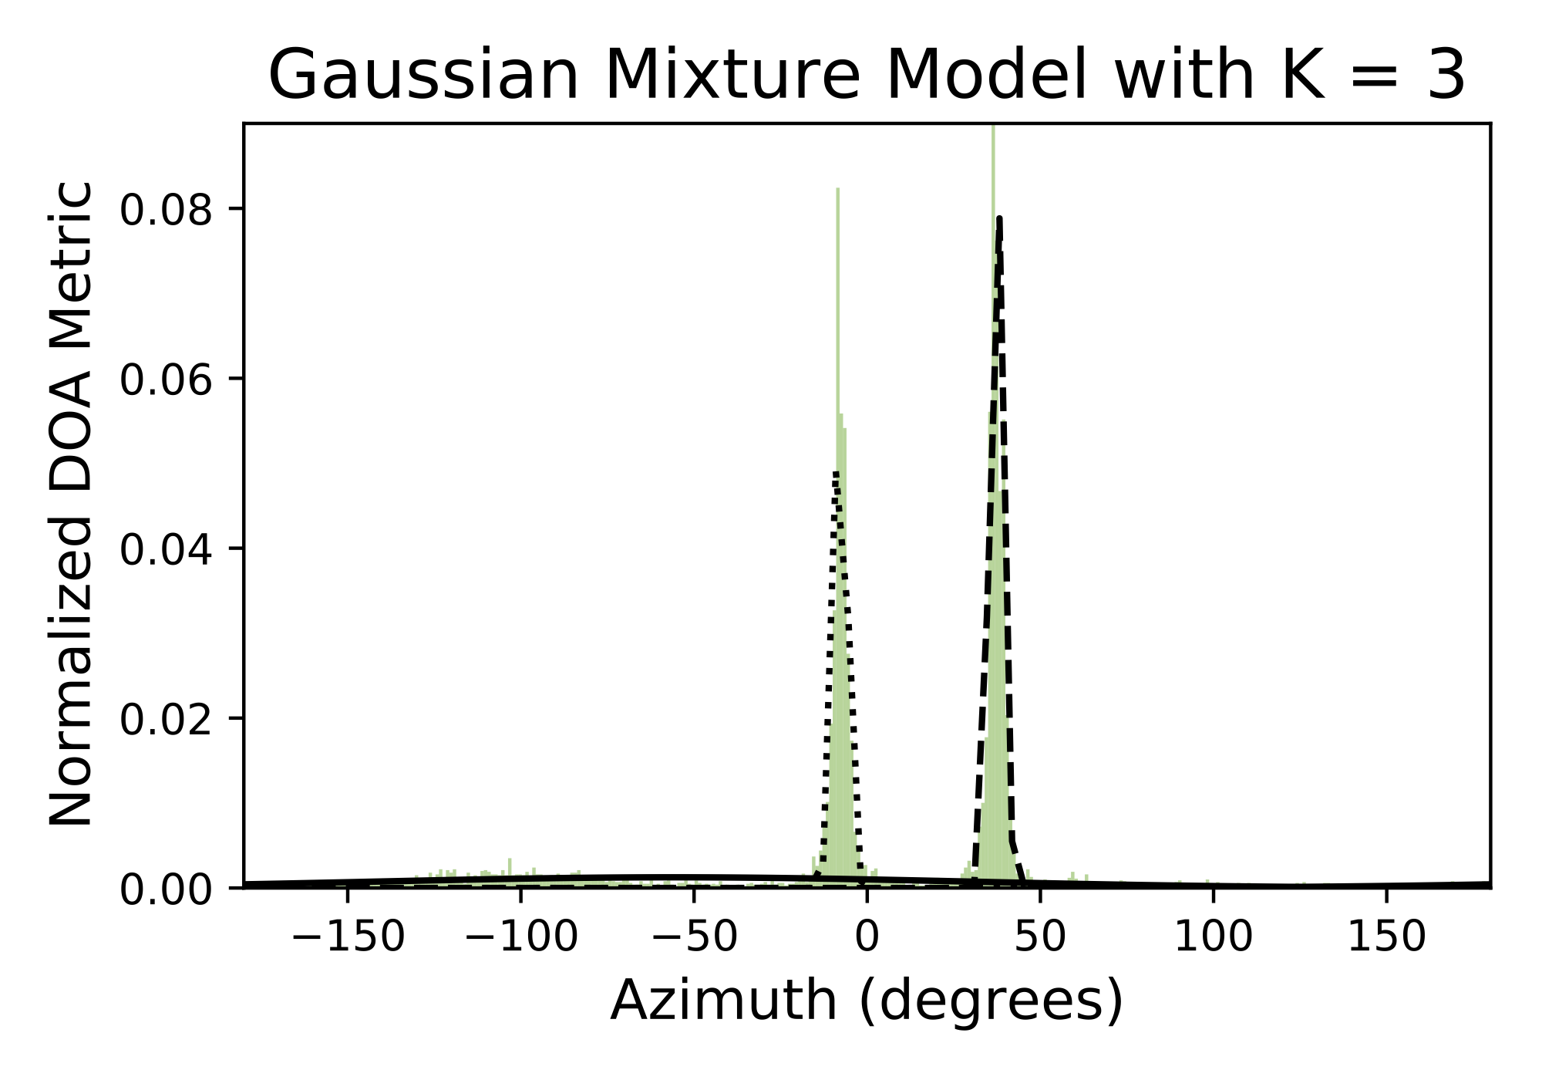
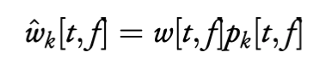
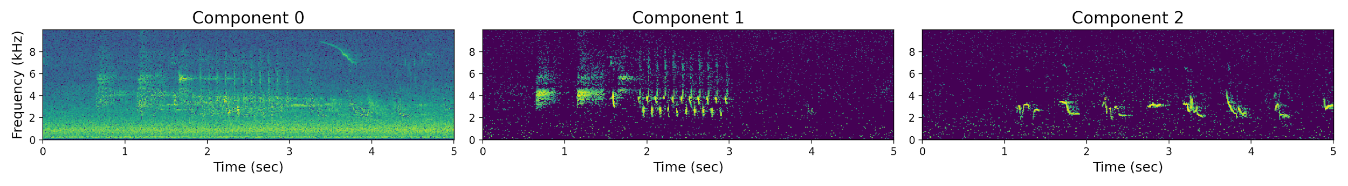
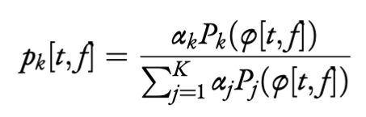
Source Separation
One approach: fit a wrapped Gaussian mixture model.
For each component, multiply the spectrogram pixel-wise by the corresponding membership probabilities.
Each of the Gaussian components would then represent a sound source with a particular mean azimuth and standard deviation.
How can we reconstruct the spectrograms corresponding to these sources?
membership
probability:
With an inverse Fourier Transform, we can obtain a time-domain signal!

Slide 18
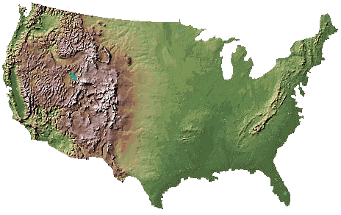
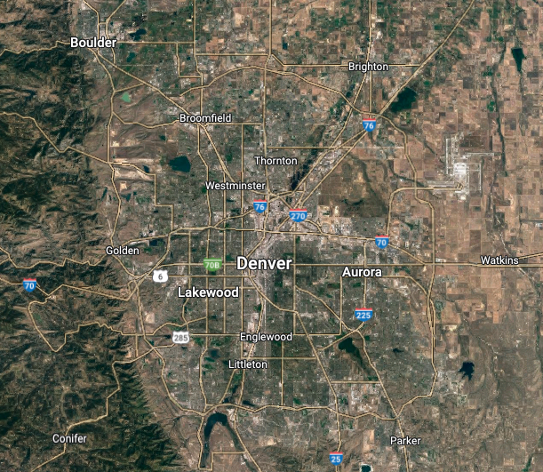
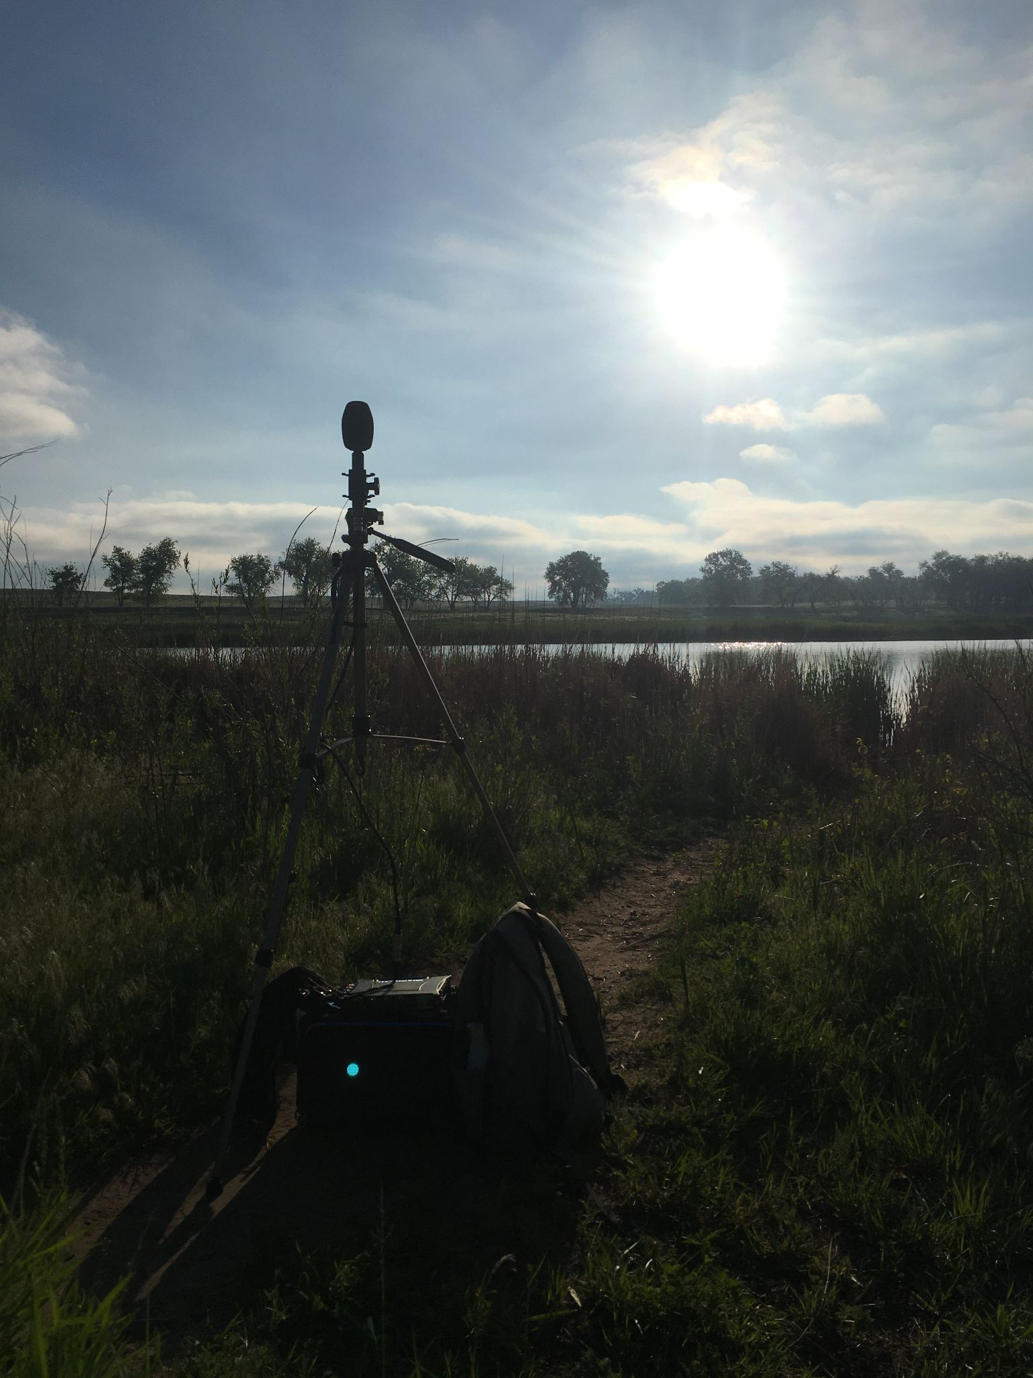
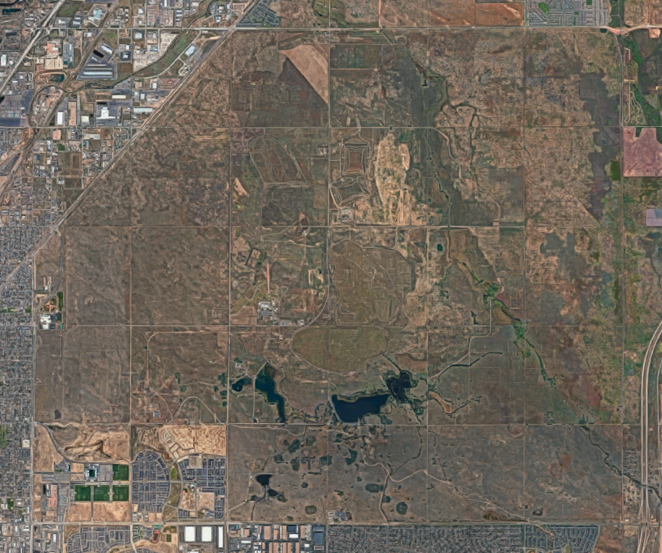
Field Recording
I recorded for 30 minutes during the peak of bird vocal activity: the dawn chorus during the breeding season.
Rocky Mountain Arsenal
National Wildlife Refuge

Slide 19

What the Rocky Mountain Arsenal NWR looks like:

Slide 20
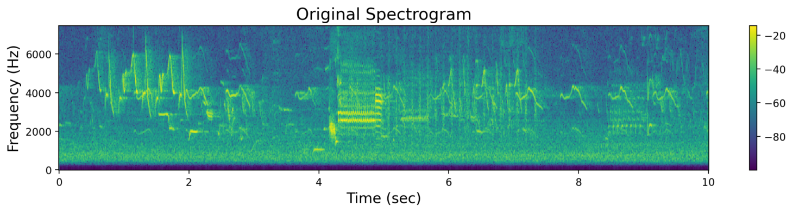
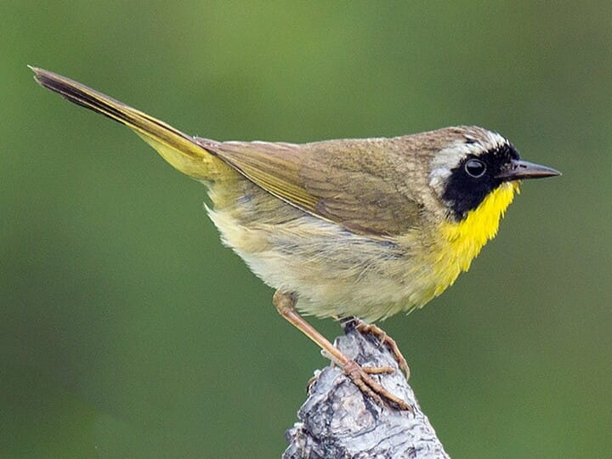
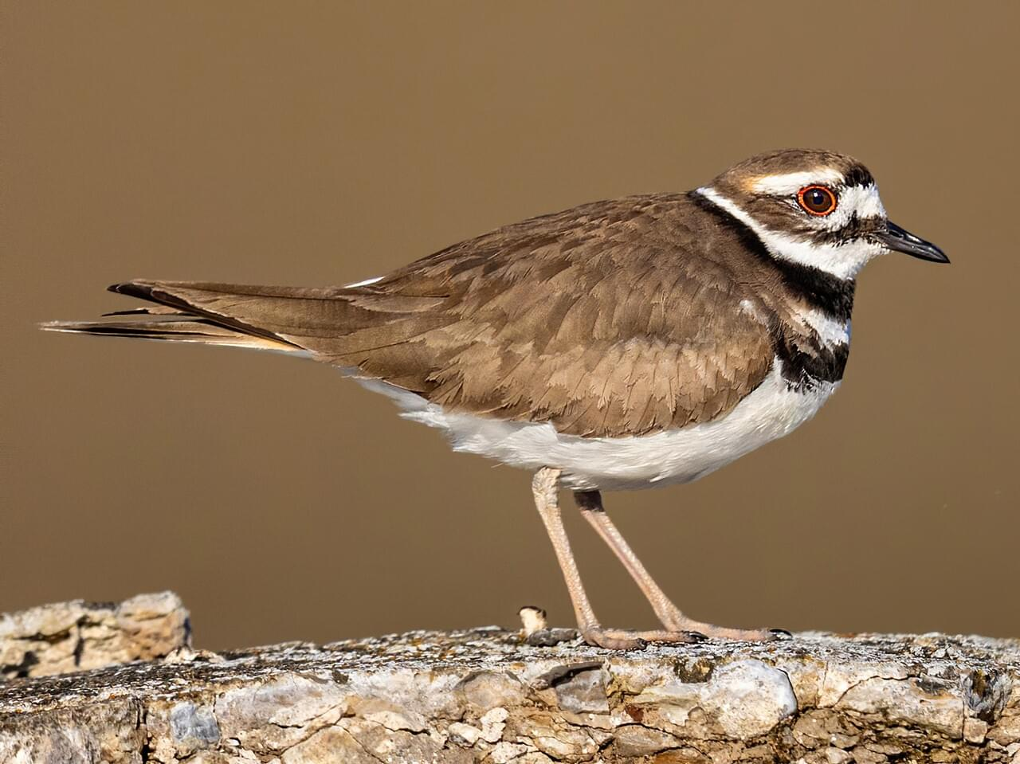
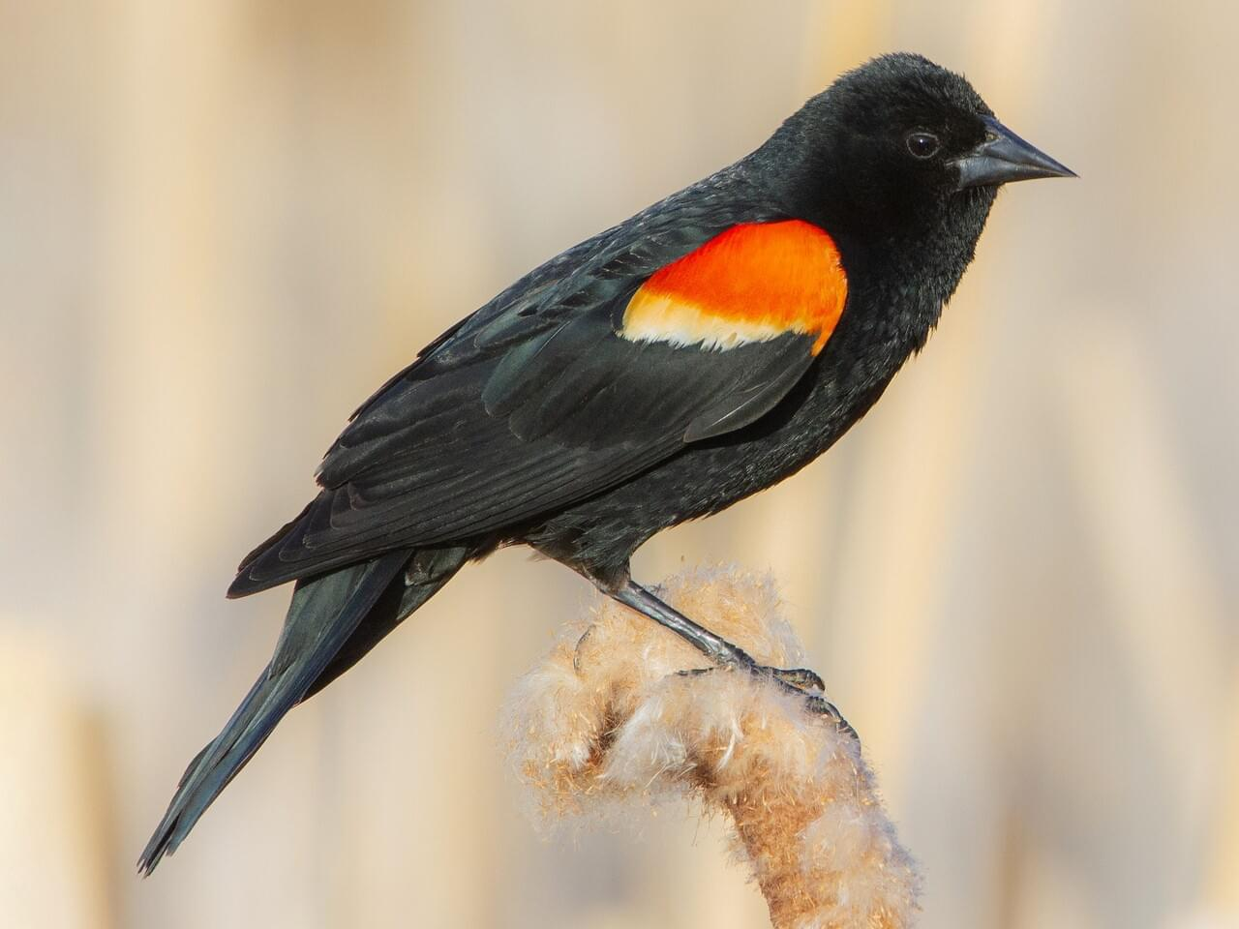
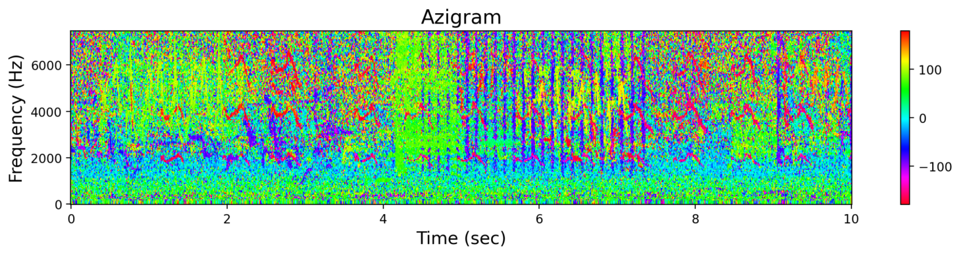
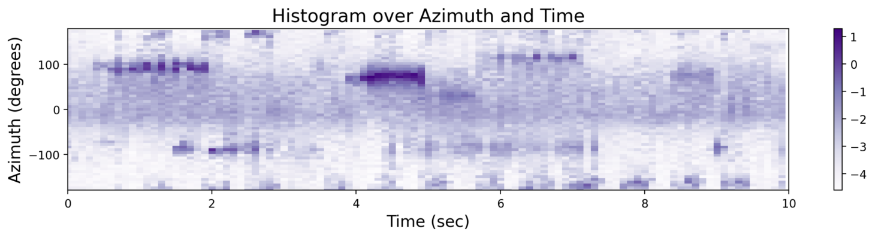
What the Rocky Mountain Arsenal NWR sounds like:
Here is a typical 10-second segment from the recording:
Spectrogram:
Azigram:
Histogram Across Time and Azimuth:

Slide 21
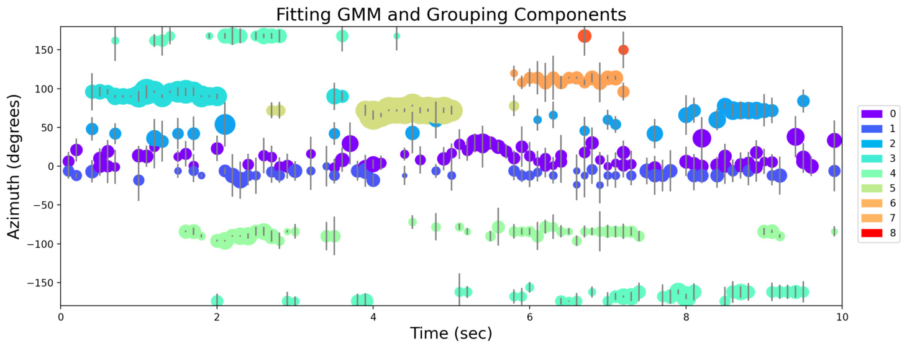
take overlapping time windows, fit GMM to azimuth samples, group components

Slide 22
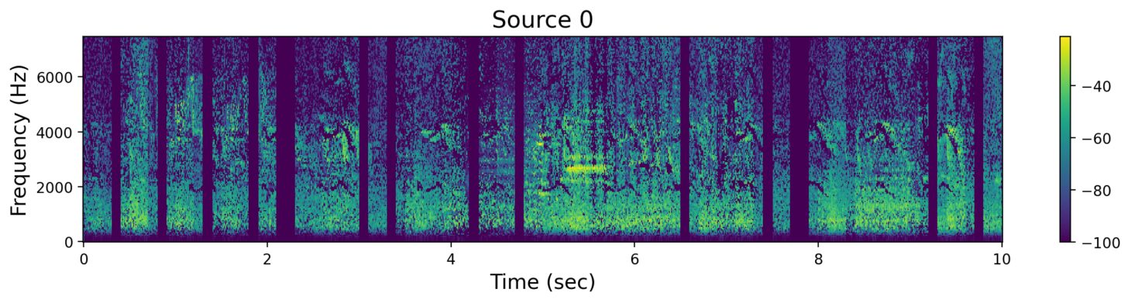
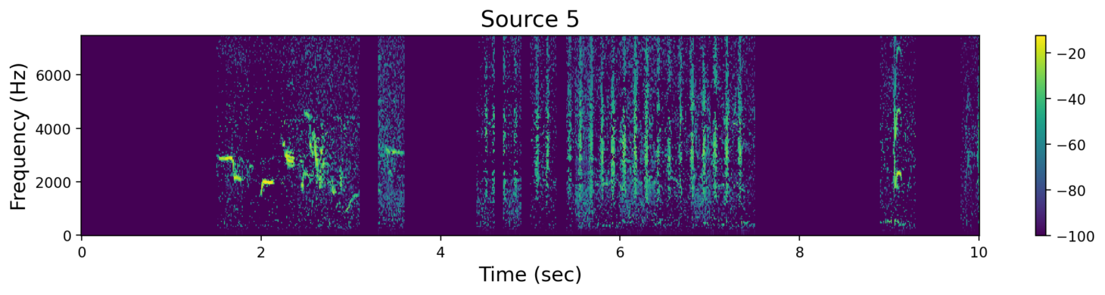
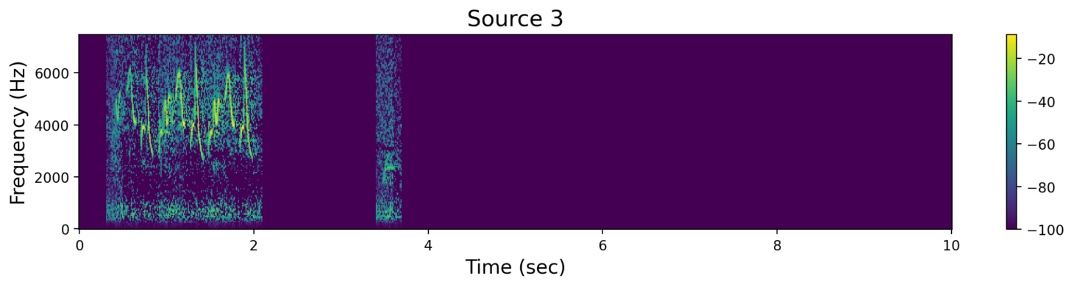
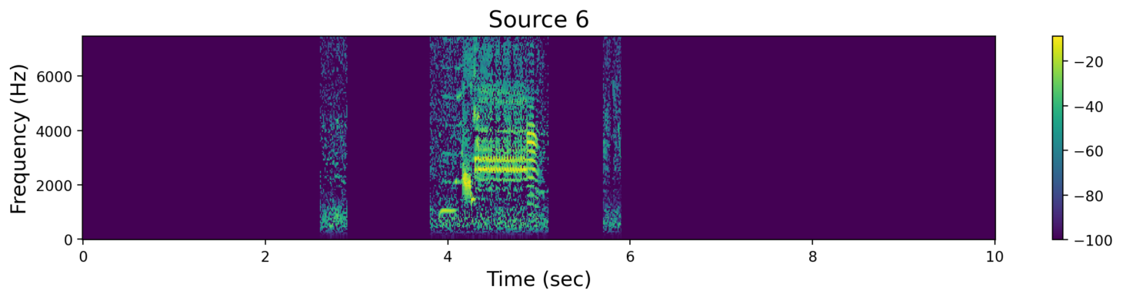
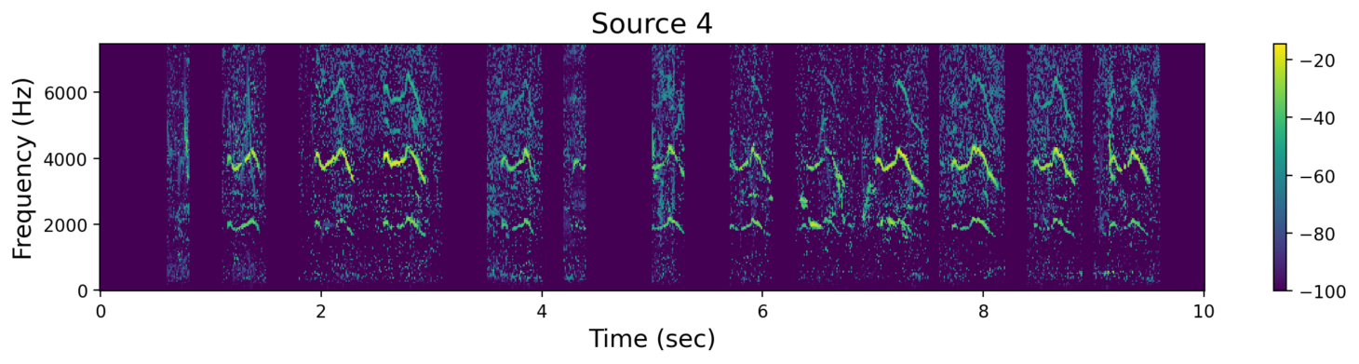
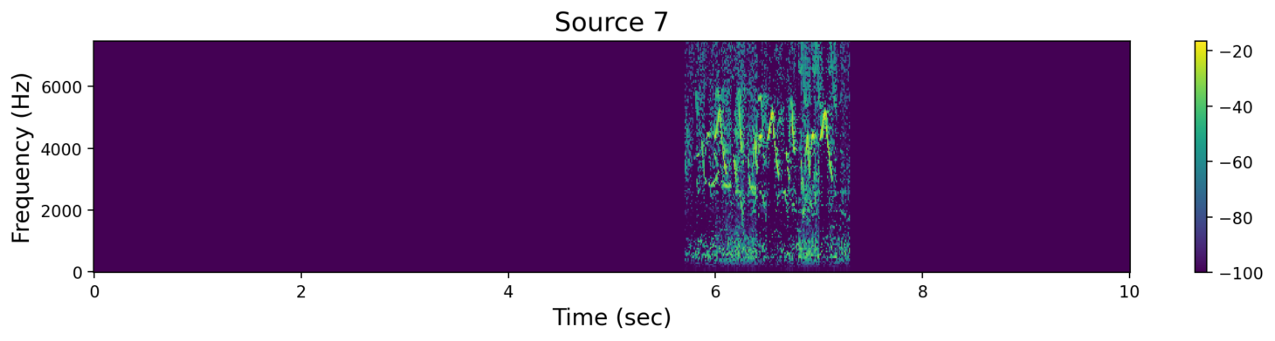

Slide 23
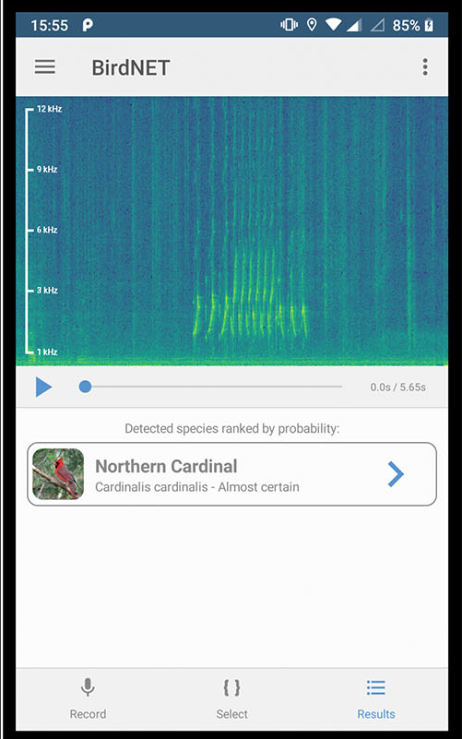
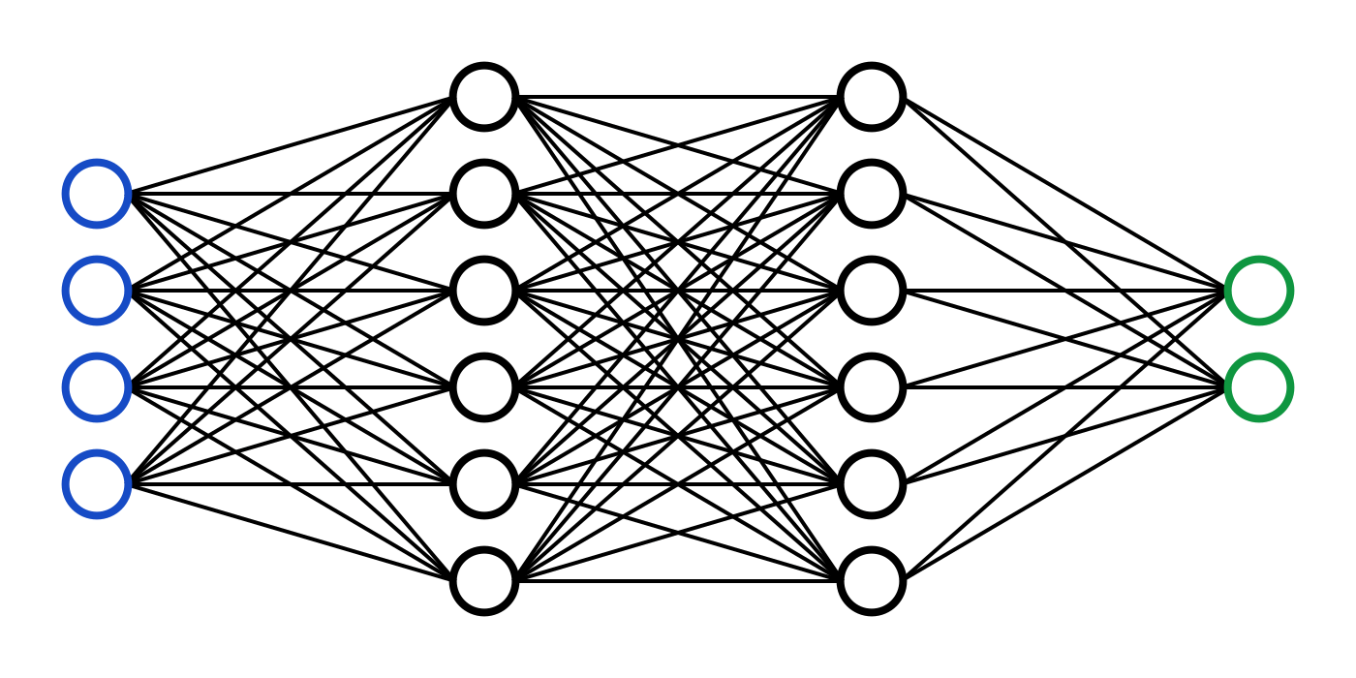

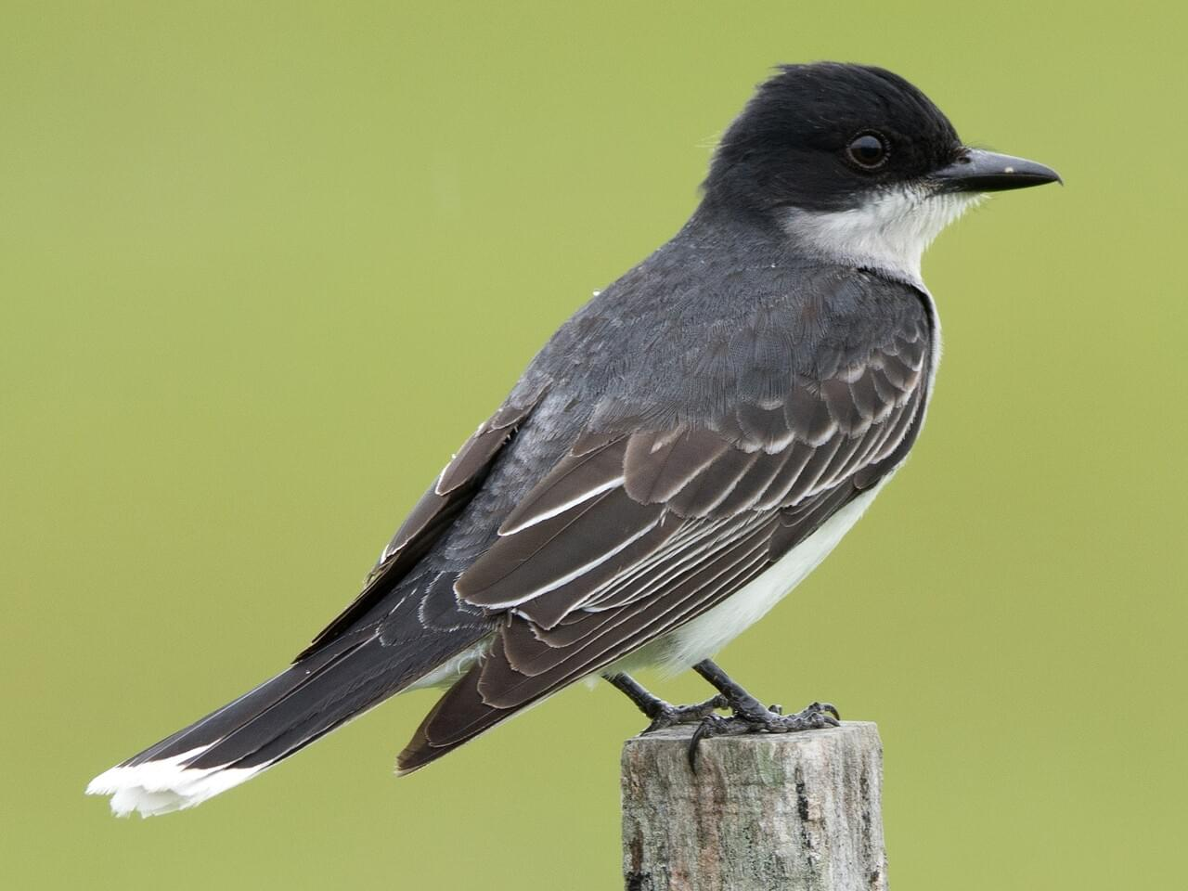
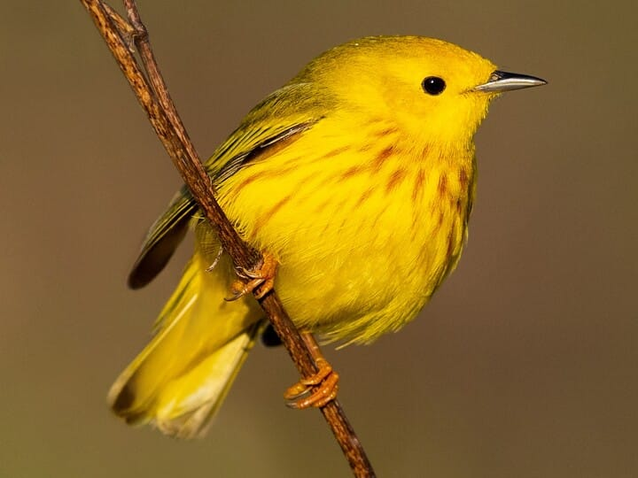

Deep-Learning-Based Classification
BirdNET, developed by the K. Lisa Yang Center at the Cornell Lab of Ornithology, is one example of an automated passive acoustic monitoring system.
A repository of labeled birdsong submitted by birders…
…is used to train a convolutional neural network…
…which outputs prediction probabilities across ~3000 species.
0.56
0.82
0.11

Slide 24




What are the classifications for the original spectrogram?
0.11
0.18
0.11
0.32
0.19
What are the classifications for the sources?
✘
0.11
0.86
0.81
0.60
0.16
0.98
0.69
0.46
0.13
✘
0.68
0.66
0.20
0.12
0.22
0.59
0.42
0.28
0.22
0.13
✘

Slide 25



Classification Performance Metrics
For a binary classification task, there are four possible outcomes:
Algorithm Prediction
true positive (TP) | false negative (FN)
false positive (FP) | true negative (TN)
Human Label
Precision: Of the algorithm’s “positive” predictions, how many are actually positive?
Recall: Of the samples labeled “positive”, how many were detected by the algorithm?
F1-score: harmonic mean of the precision and recall.

Slide 26


Species-Level F1 Scores: With and Without Source Separation
standard classifier
with source separation

Slide 27
Species-Level F1 Scores: With and Without Source Separation
standard classifier
with source separation

Slide 28

Common Yellowthroat
In all of these 3-second segments, BirdNET with source separation predicted a common yellowthroat.

Slide 29





Common Yellowthroat
Red-winged Blackbird
Killdeer
Canada Goose
Eastern Kingbird

Slide 30
Common Yellowthroat
Red-winged Blackbird
Killdeer
Canada Goose
Eastern Kingbird

Slide 31
Common Yellowthroat
Red-winged Blackbird
Killdeer
Canada Goose
Eastern Kingbird

Slide 32
Common Yellowthroat
Red-winged Blackbird
Killdeer
Canada Goose
Eastern Kingbird

Slide 33
Common Yellowthroat
Red-winged Blackbird
Killdeer
Canada Goose
Eastern Kingbird

Slide 34
Common Yellowthroat
Red-winged Blackbird
Killdeer
Canada Goose
Eastern Kingbird

Slide 35

Species Directionality
Can we make any ecological conclusions from the spatial information associated with our predictions?
Recording Location
trees
field
marsh
lake

Slide 36

Species Directionality
Recording Location

Slide 37
Species Directionality
Recording Location

Slide 38
Species Directionality
Recording Location
water-dwelling species: Canada goose
mallard
killdeer

Slide 39
Species Directionality
Recording Location
woodland- and marsh- dwelling species

Slide 40

In all, we find that performing source separation on natural recordings…
→ Results in substantial improvement in F1 scores for species-level classification (within 3-second windows).
→ Enables visualization of the soundscape as well as local spatial analysis.
→ Enables the classifier to detect more calls with higher confidence.
Can we apply borrow methods from state estimation to make the grouping of sources more robust?
Can we use two acoustic vector-sensors to perform full spatial localization?
Can we estimate the elevation angle to separate sources in 3D?

Slide 41



Prof. Holger Klinck
Dan Salisbury
Stefan Kahl
K. Lisa Yang Center for Conservation Bioacoustics

